Slide 1
ENTERPRISE PERFORMANCE MANAGEMENT
Performance Management System
A bilingual, workflow-driven employee performance review platform
built on ASP.NET Core 8, Entity Framework Core, and PostgreSQL.
v1.0.0 · Production Readiness Reviewed · English / Arabic (RTL)

Slide 2
OVERVIEW
Agenda
01
Business objectives & target users
05
Workflow Administration & recovery
02
Technology stack & architecture
06
Localization, security & audit
03
The performance review workflow
07
Testing, deployment & release readiness
04
Core modules — dashboard, reports, master data
08
Future roadmap
Performance Management System · v1.0.0
2

Slide 3
WHY THIS EXISTS
The business problem
Annual performance appraisal at most mid-size organizations runs on spreadsheets, email chains, and a legacy system nobody wants to touch. There is no enforced workflow, no audit trail, no self-service reporting, and no bilingual support.
7
2
workflow stages,
fully enforced
languages,
full RTL support
This system replaces that with a single, auditable, workflow-enforced platform — every review moves through a fixed, timestamped sequence, and every exceptional situation has an explicit, audited recovery path instead of a database admin editing rows by hand.
6
100%
automated
recovery actions
of transitions
audited
Performance Management System · v1.0.0
3

Slide 4
WHO USES IT
Four roles, one platform
Employee
Manager
HR Reviewer
Administrator
Views KPIs/competencies, acknowledges, self-assesses, reviews final rating.
Sets KPIs and competencies, scores achievement, submits to HR.
Two-stage independent approval — segregation of duties enforced.
Full system administration, reporting, and the Workflow Administration recovery console.
Performance Management System · v1.0.0
4

Slide 5
FOUNDATION
Built on a modern, secure foundation
Runtime & framework
Automated scheduling
.NET 8 · ASP.NET Core 8 Razor Pages
Review cycles, reminders, and escalations run automatically
Business data layer
PDF reporting
Secure, structured access to all performance data
High-fidelity, print-ready PDF reports
Database
Excel reporting
PostgreSQL 16
Native, ready-to-analyze Excel exports
Localization
Data protection
Full English and Arabic support, including right-to-left layout
Passwords and credentials encrypted, never stored in plain text
Email
Testing
Branded, bilingual email notifications
Automated regression testing on every change
Performance Management System · v1.0.0
5

Slide 6
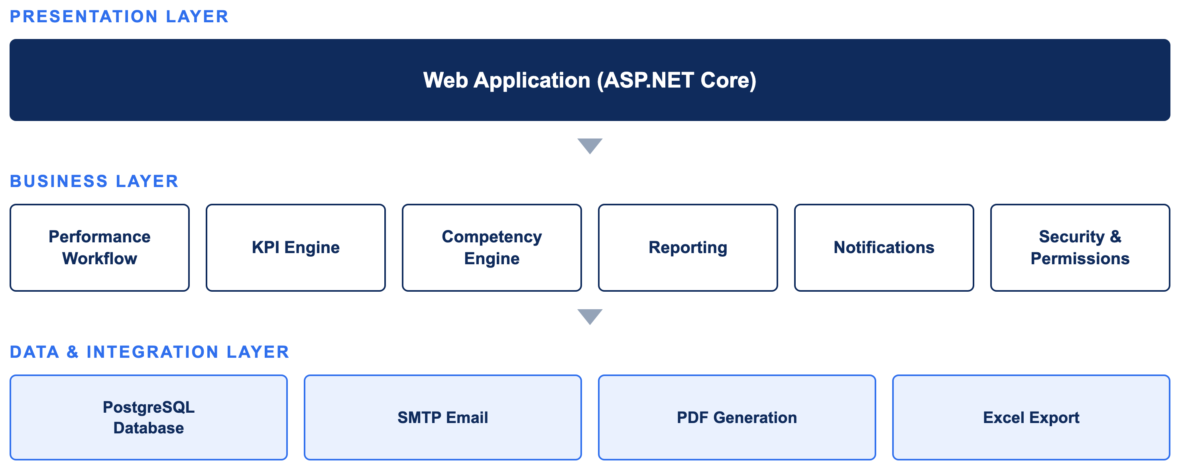
ARCHITECTURE
System architecture
Performance Management System · v1.0.0
6
Notes:
The solution follows a layered architecture. The web application provides the user interface, while the business layer manages workflows, KPIs, reporting, notifications, permissions, and security. Data is stored securely in PostgreSQL, with integrated email notifications and PDF/Excel reporting. This layered design makes the system scalable, maintainable, and easy to extend.

Slide 7
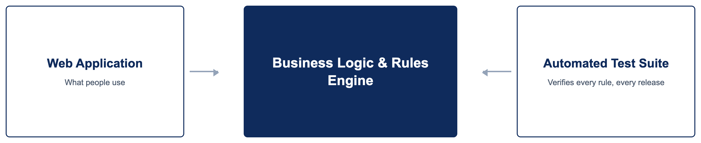
ARCHITECTURE
Built for reliability
Business logic is fully decoupled from the user interface and verified automatically before every release — enabling safe, frequent updates with confidence.
Performance Management System · v1.0.0
7
Notes:
The interface and the business rules are cleanly separated, so every workflow, scoring, and permission rule is covered by automated tests independent of the web application itself. That separation is what lets the team ship changes quickly without putting the live system at risk.

Slide 8
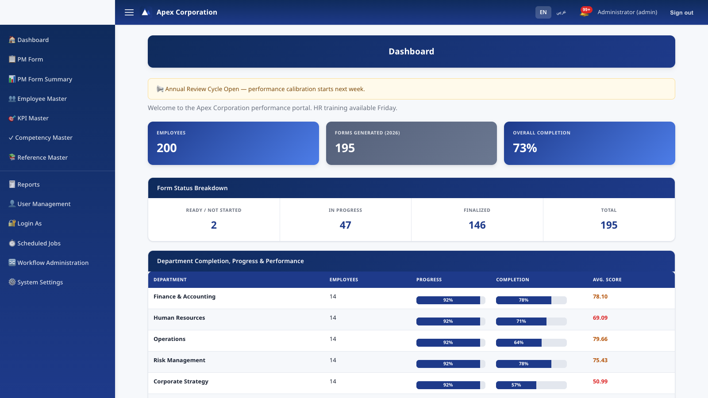
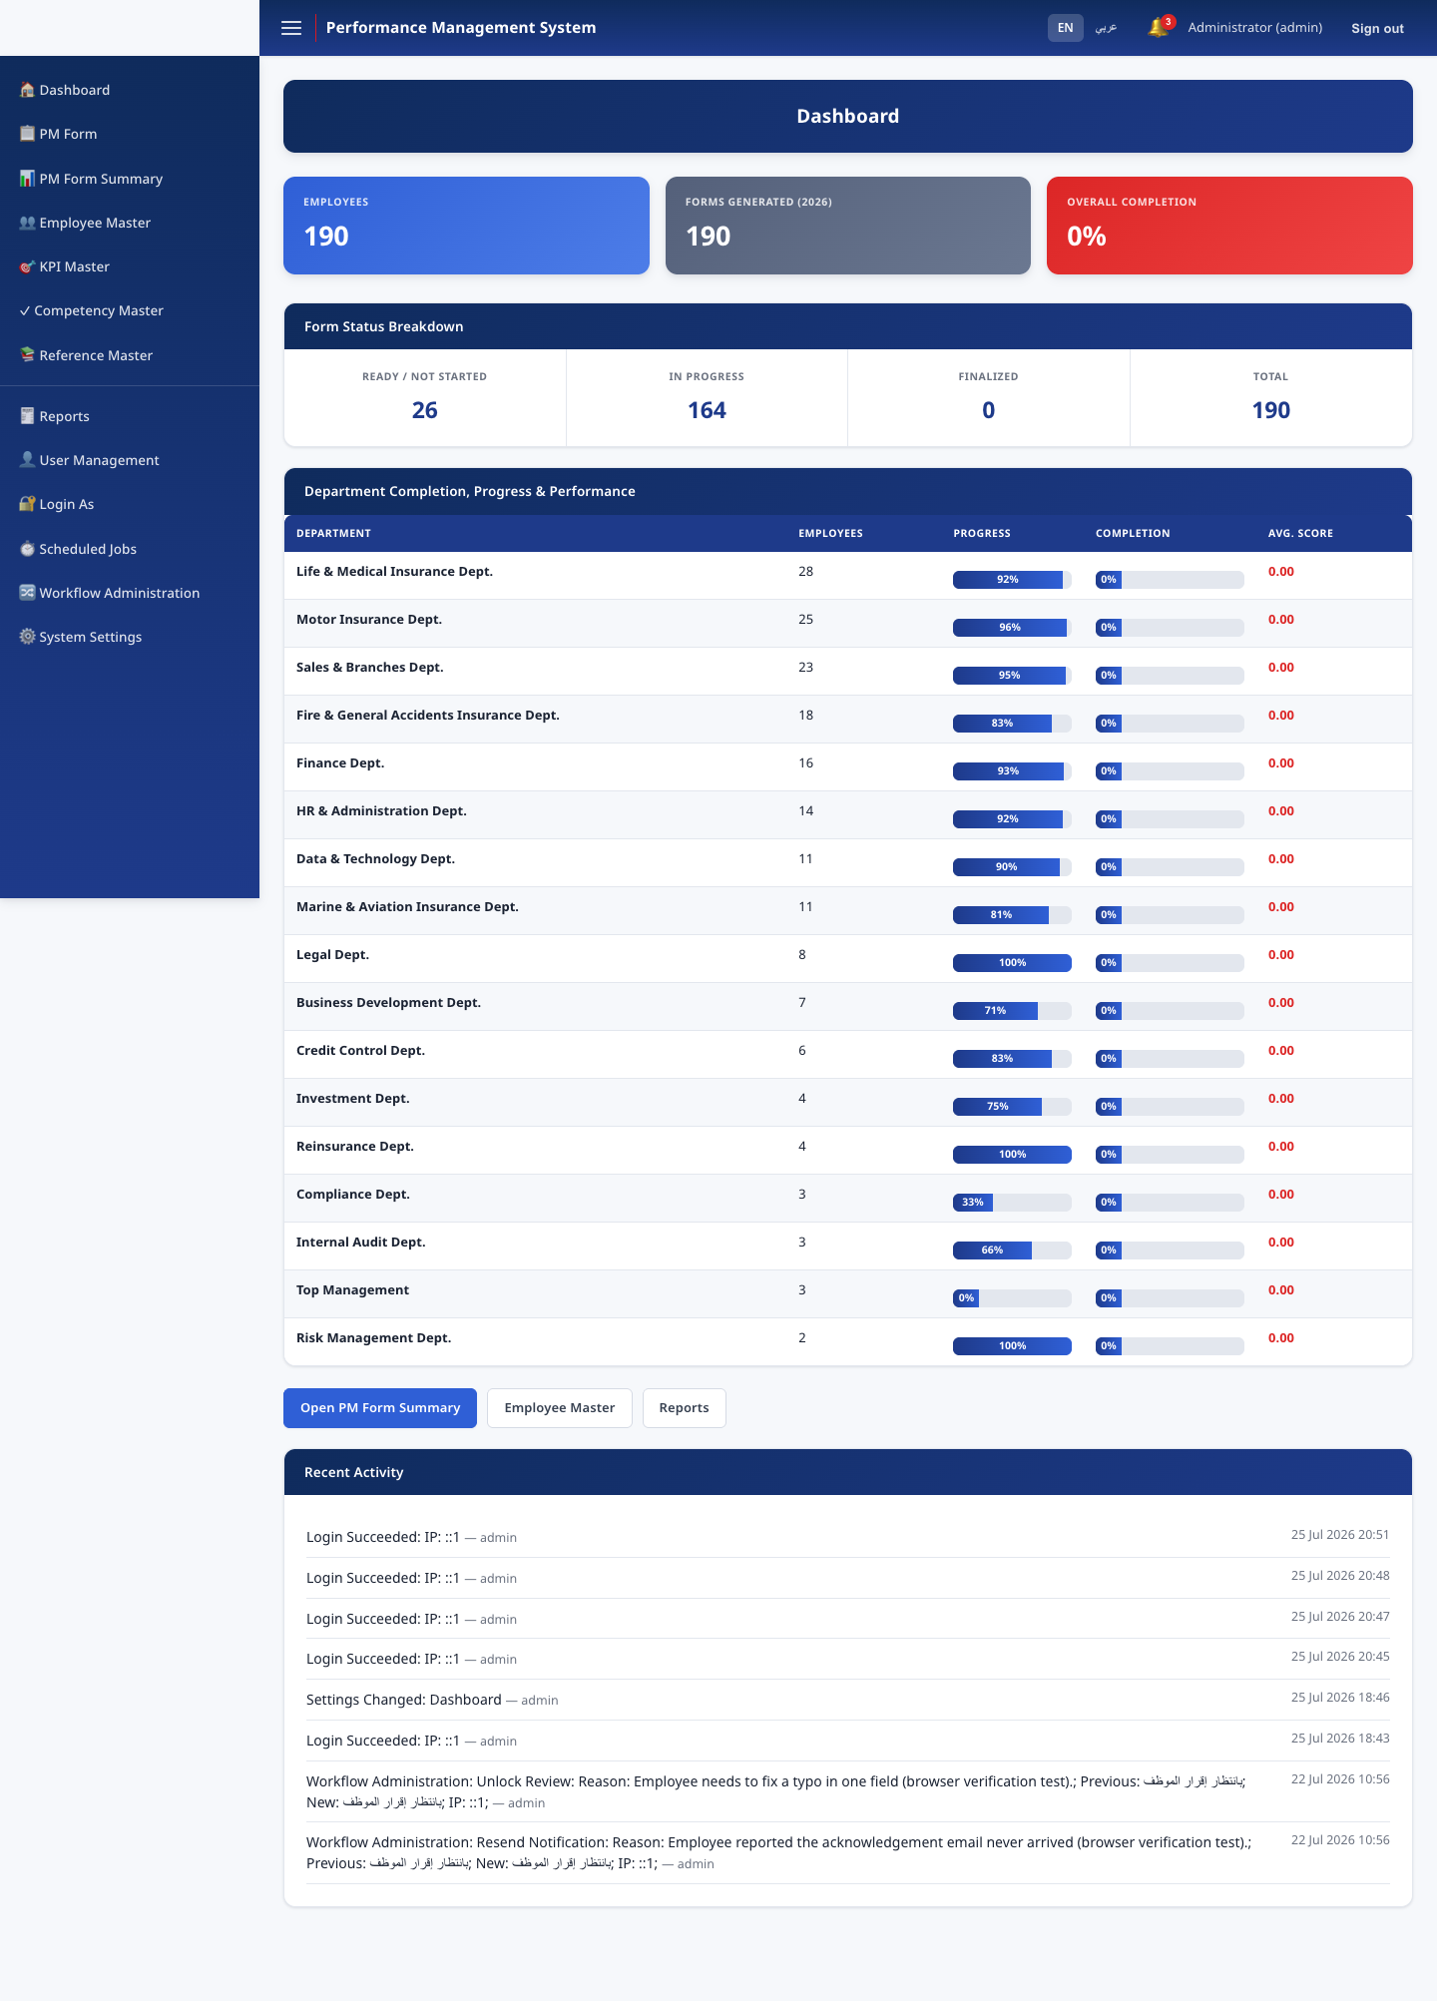
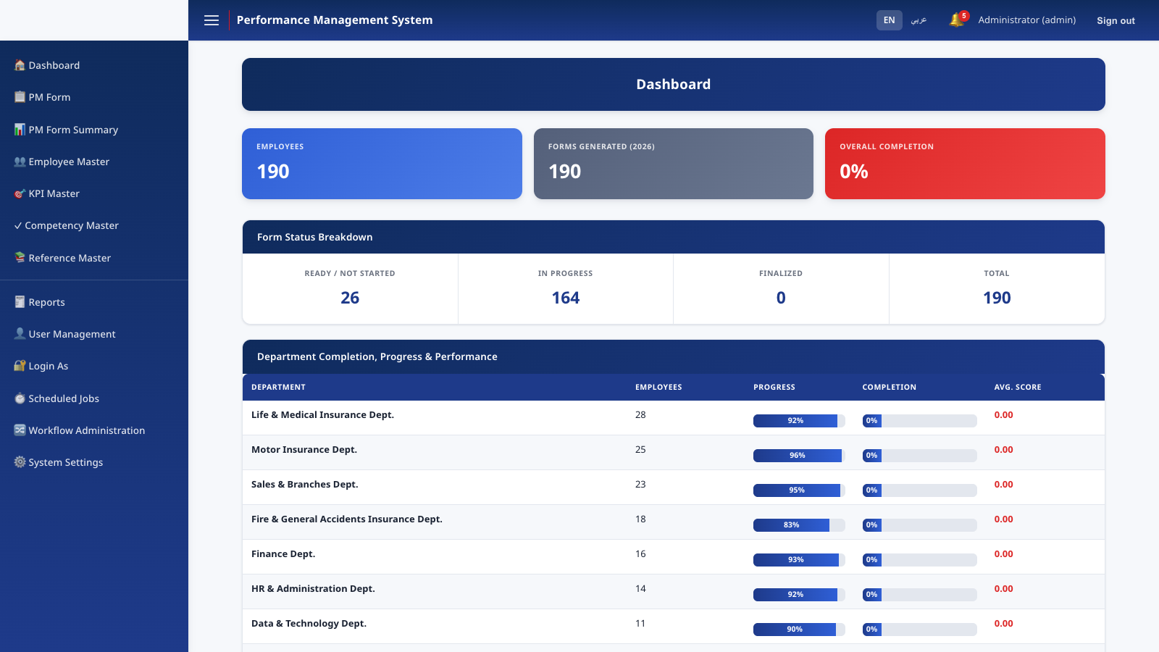
MODULES
Dashboard
Organization-wide completion metrics, per-department breakdown, form-status summary, and a live recent-activity feed drawn directly from the audit trail.
Performance Management System · v1.0.0
8

Slide 9
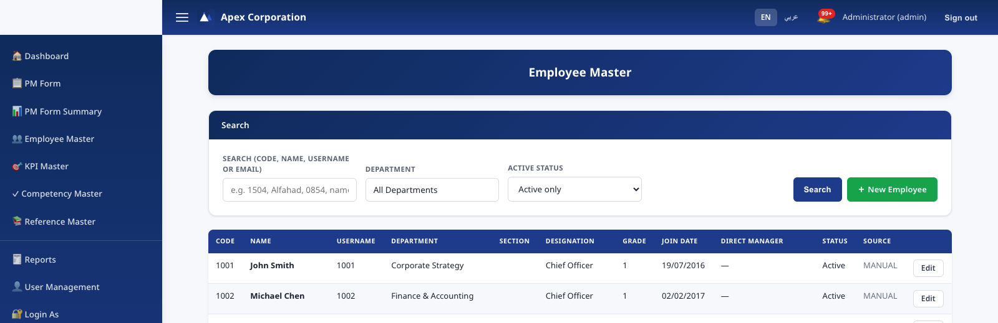
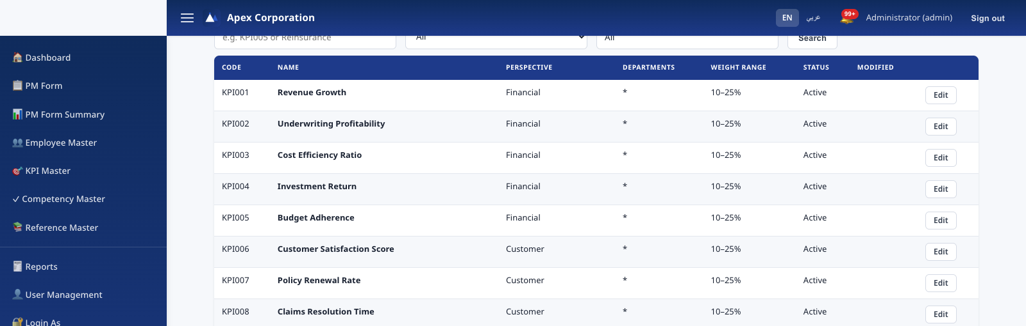
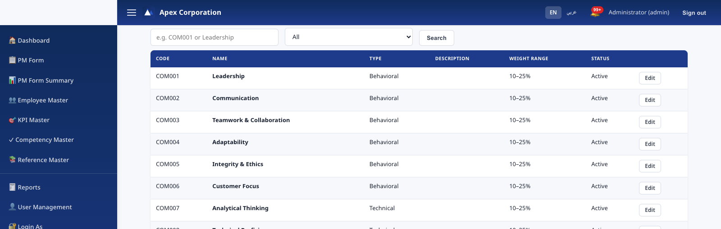
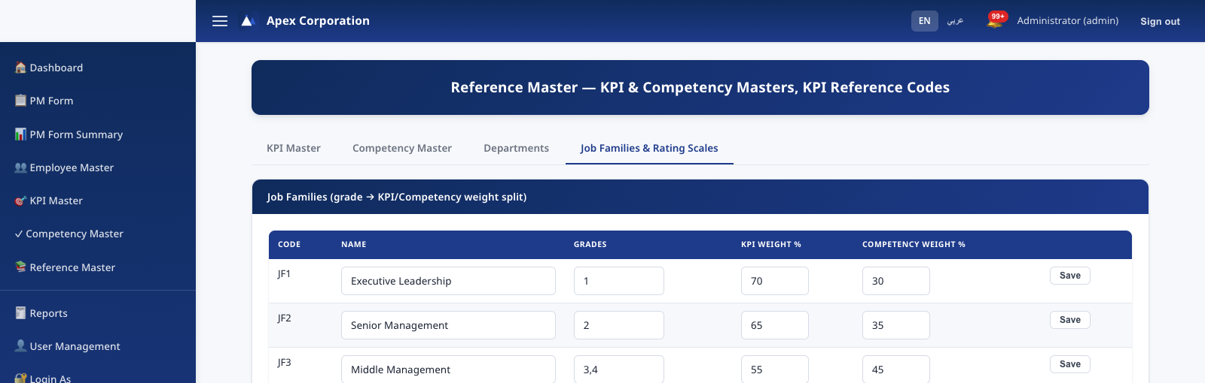
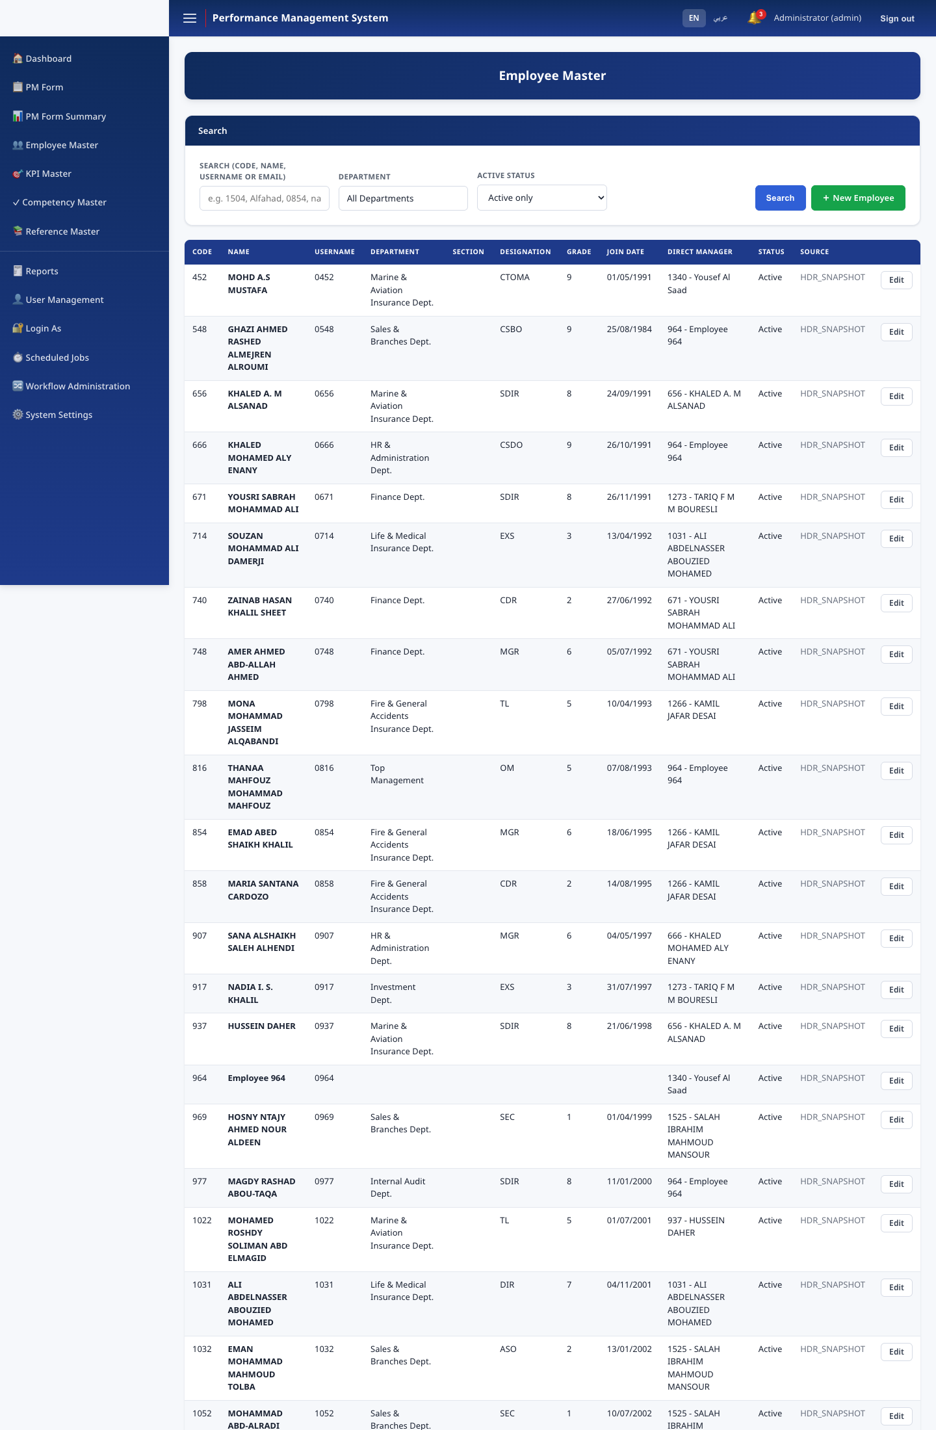
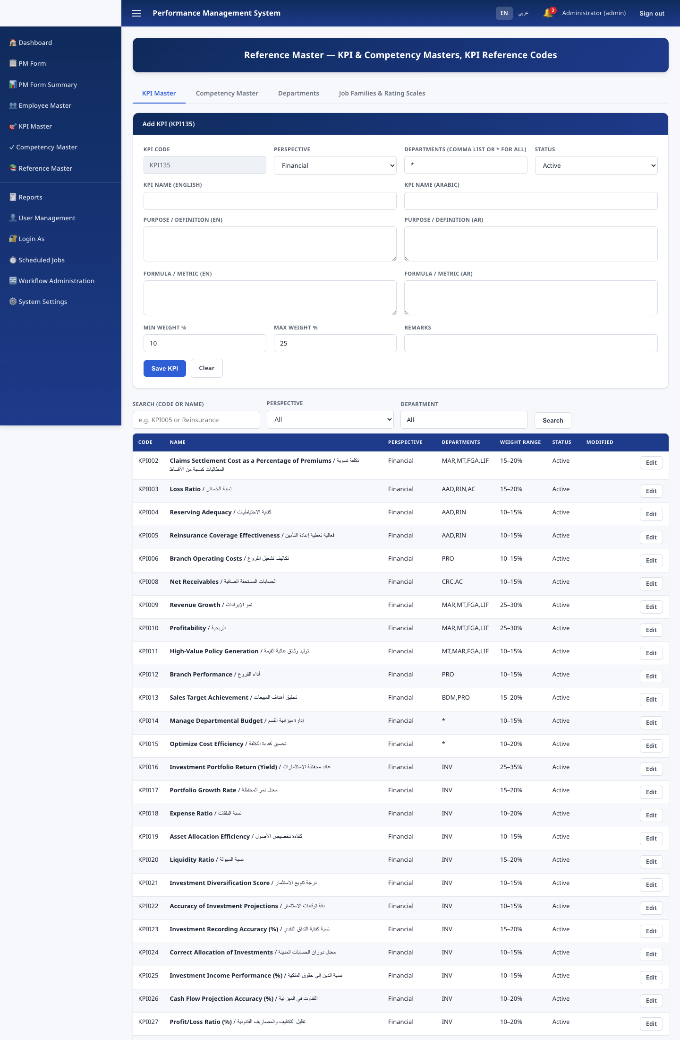
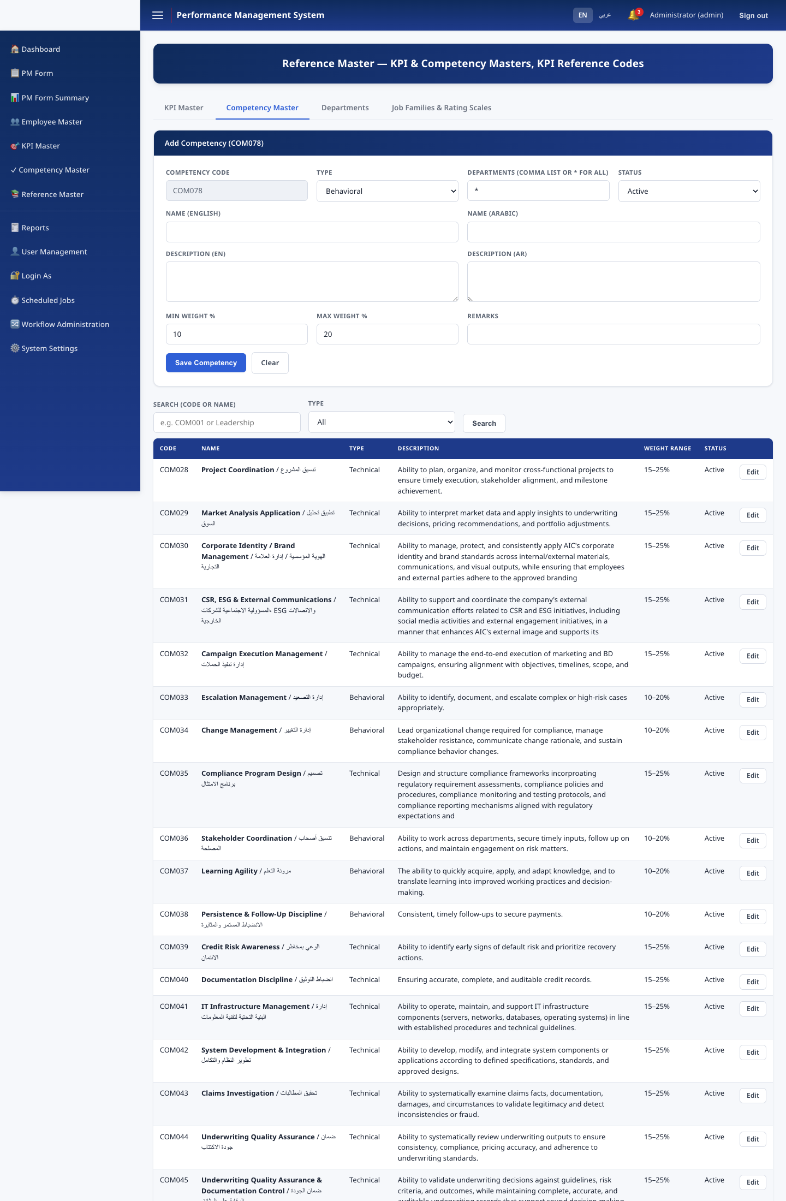
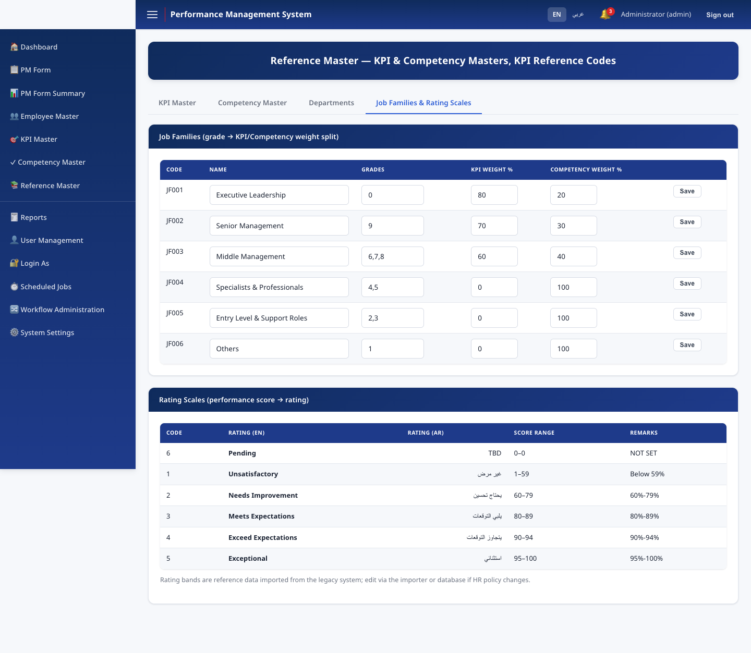
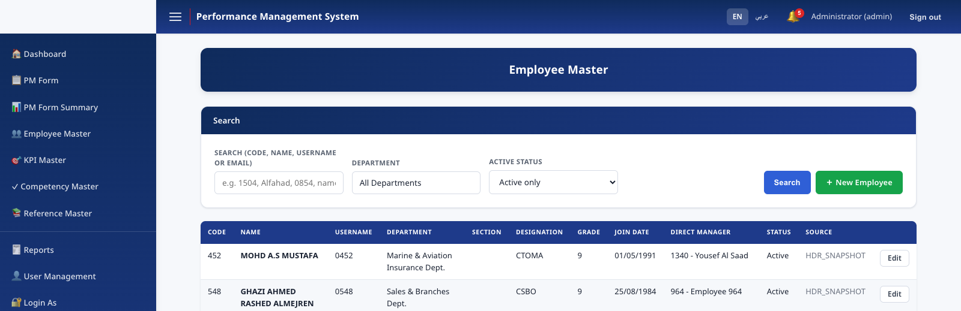
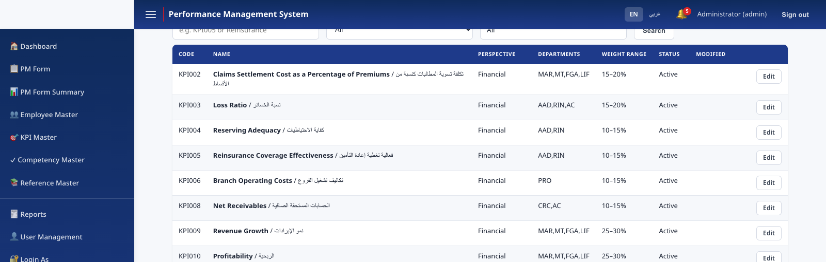
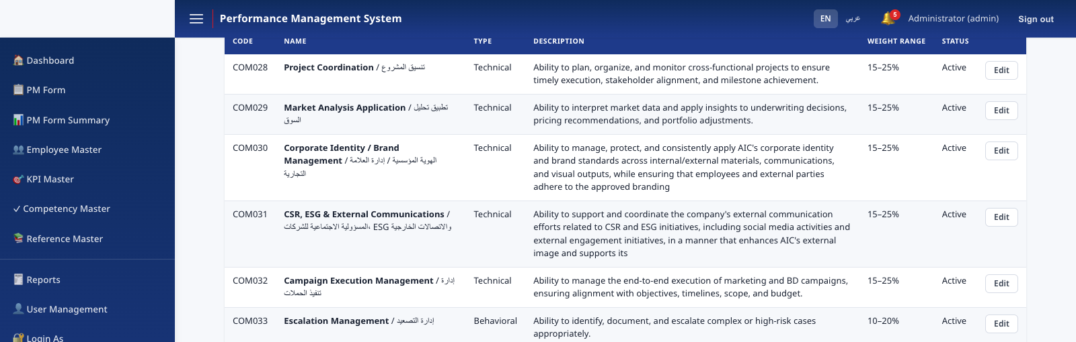

MODULES
Employee & reference master data
Employee Master, Department Master, KPI Master, Competency Master, Job Families, and Rating Scales — all bilingual, all HR-Administrator editable.
Employee Master
KPI Master
Competency Master
Job Families & Rating Scales
Performance Management System · v1.0.0
9

Slide 10
THE CORE WORKFLOW
Seven stages, fully enforced
KPI
Creation
→
Employee
Ack.
→
Manager
Review
→
Submitted
to HR
→
HR Review
(1st)
→
HR Review
(Final)
→
Completed
Two independent HR reviewers must approve — the same person cannot perform both HR stages (segregation of duties).
Performance Management System · v1.0.0
10

Slide 11
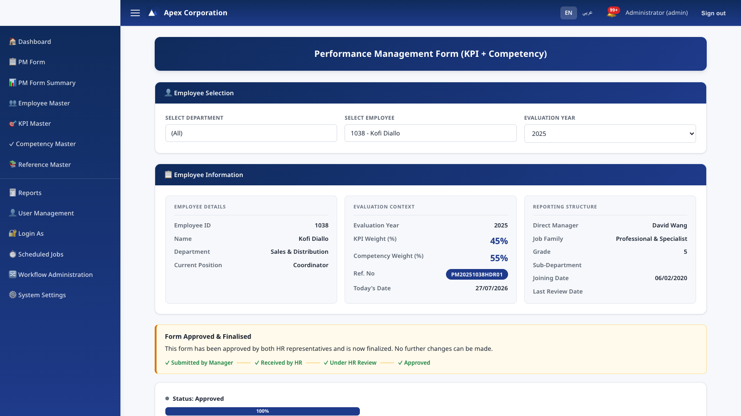
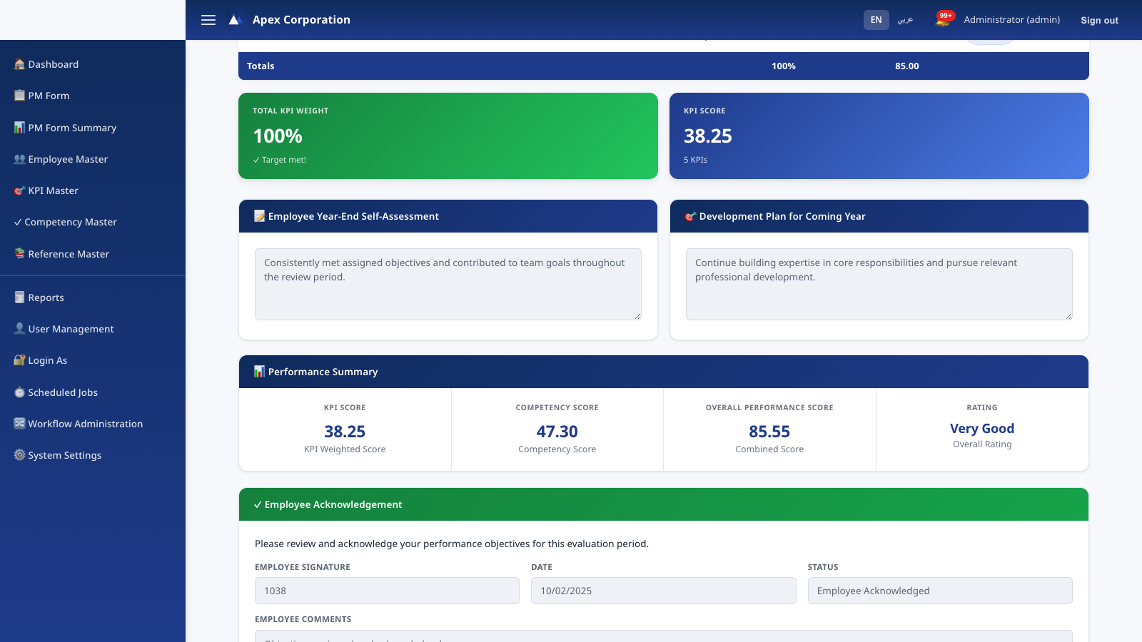
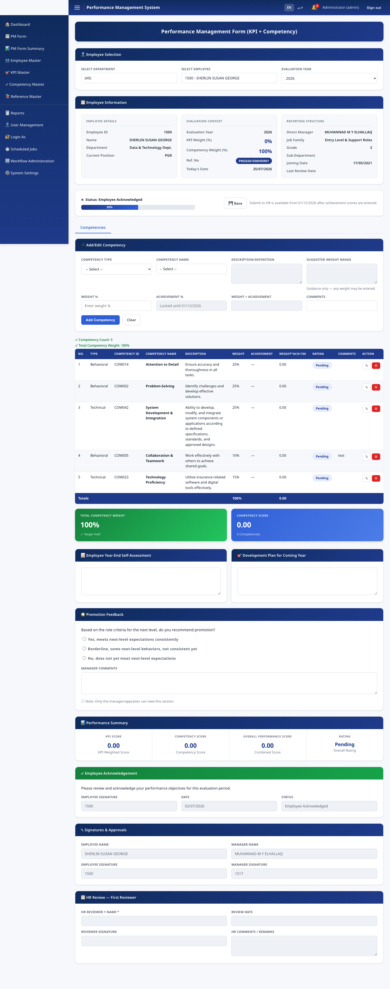
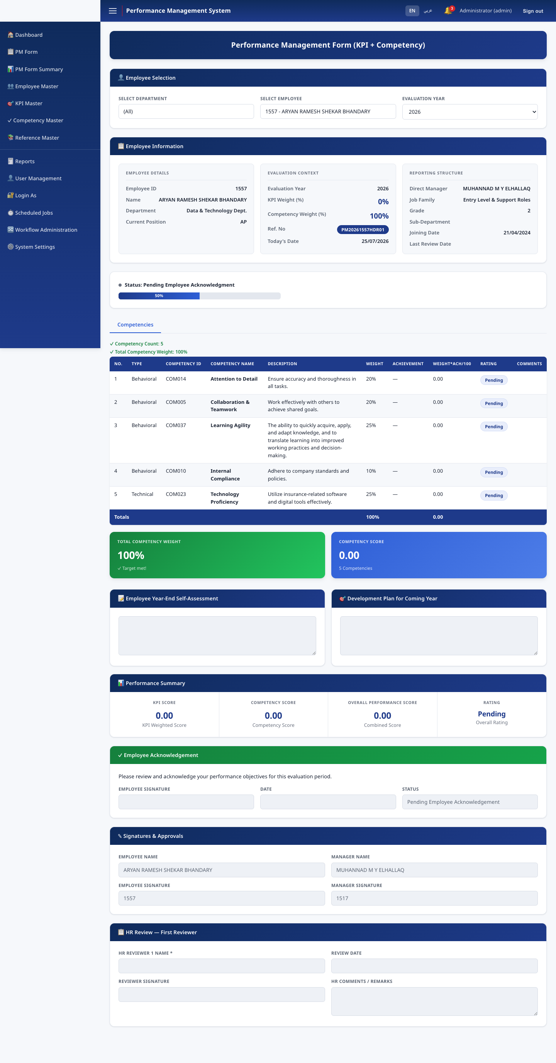
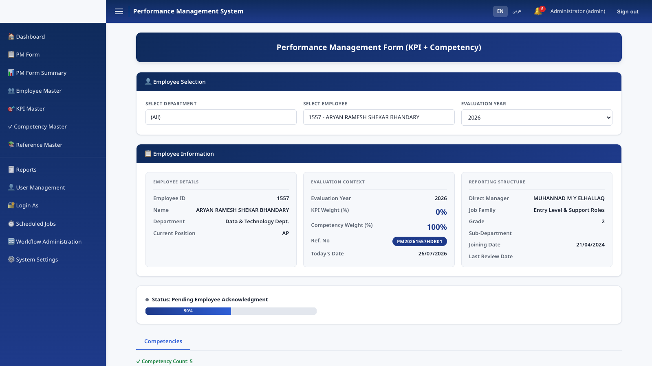
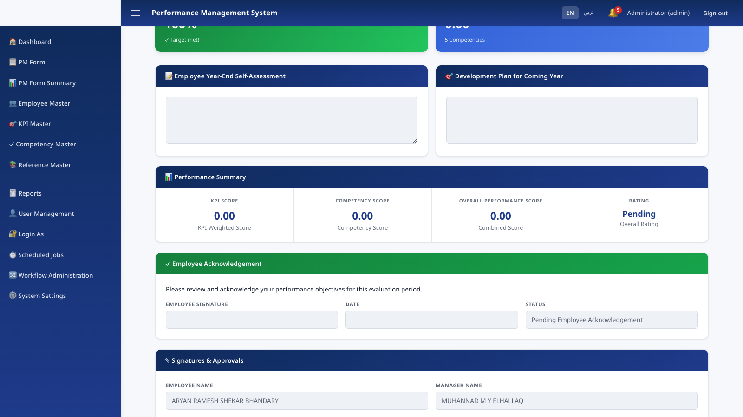
THE CORE WORKFLOW
Manager scoring & employee acknowledgement
Performance Management System · v1.0.0
11

Slide 12
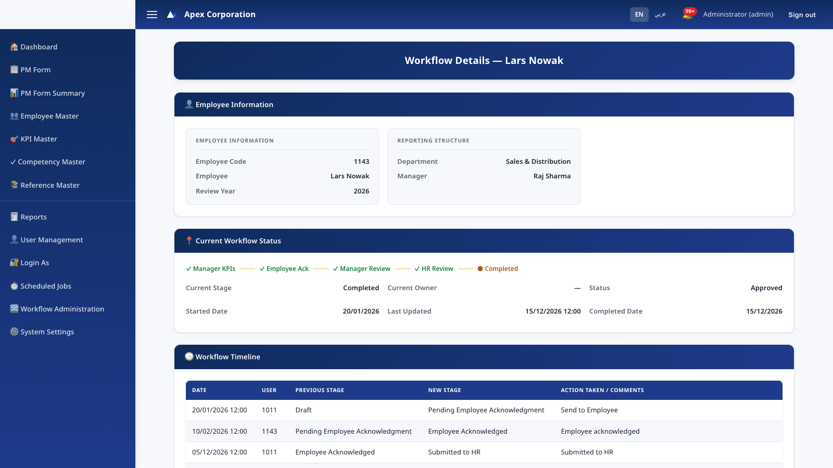
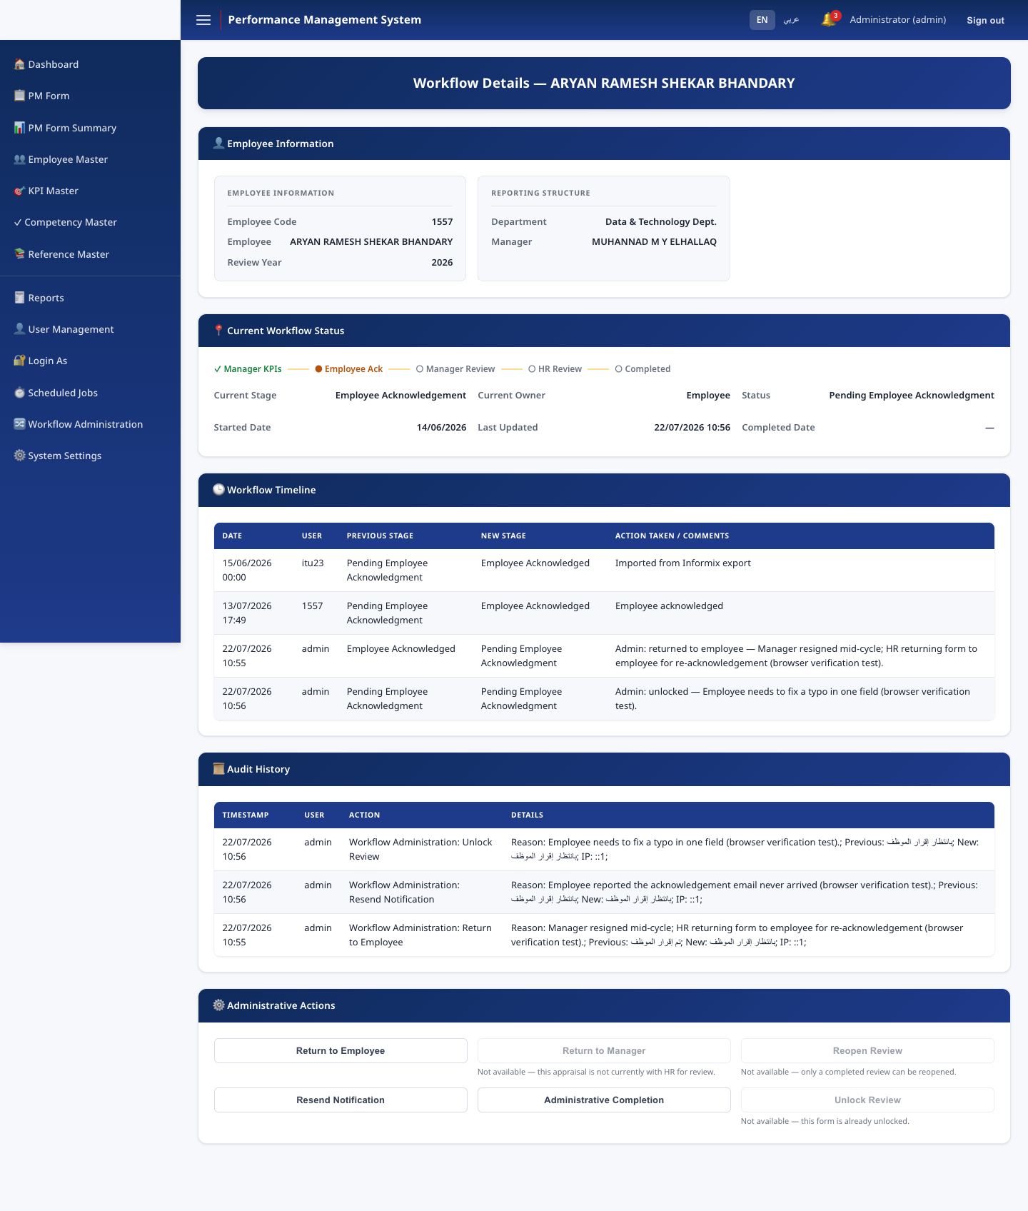
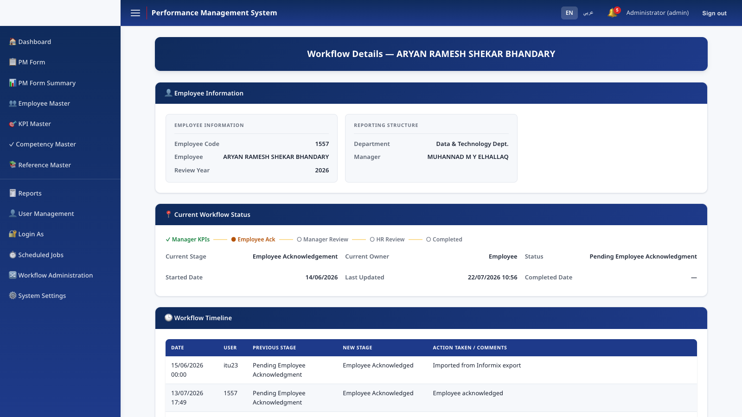
RECOVERY & CONTROL
Workflow Administration
An HR-Administrator-only recovery console for the exceptional situations a normal flow can't handle — a manager who has left mid-cycle, a wrongly approved review, a stuck workflow.
Performance Management System · v1.0.0
12

Slide 13
RECOVERY & CONTROL
Six audited recovery actions
Return to Employee
Return to Manager
Reopen Review
Re-open acknowledgement
Send back for score correction
Re-open a completed review
Resend Notification
Administrative Completion
Unlock Review
Re-send the current stage's email
Finalize on a departed reviewer's behalf
Correct one field without rewinding
Every action: mandatory typed reason · confirmation step · one audit-log entry (actor, reason, previous/new state, IP).
Performance Management System · v1.0.0
13

Slide 14
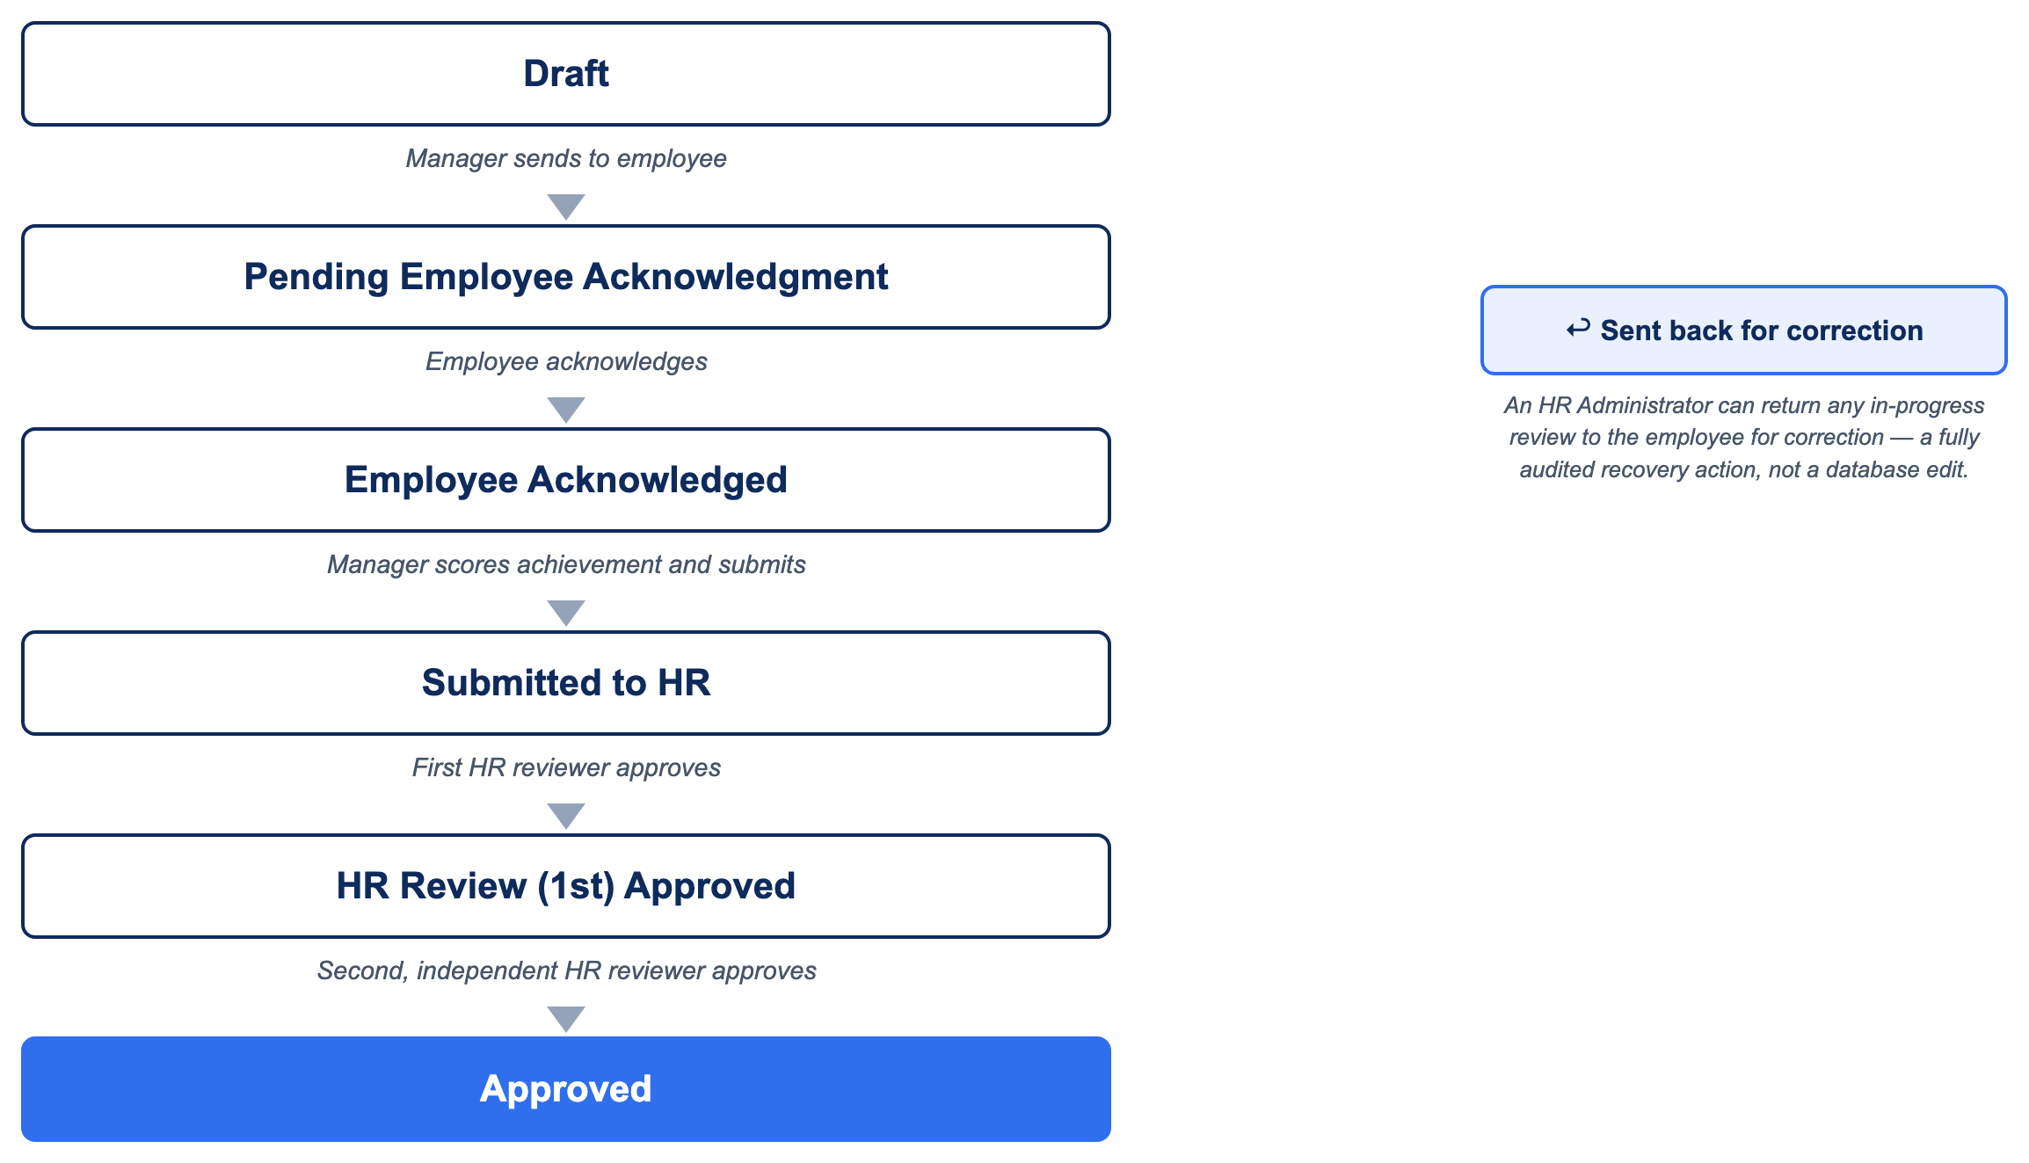
THE CORE WORKFLOW
A built-in correction path
Performance Management System · v1.0.0
14
Notes:
Every review moves through the same fixed sequence shown on the earlier stages slide. What this adds is the safety net: at any point before final approval, an HR Administrator can send a review back to the employee for correction — a deliberate, audited action, never a silent database edit.

Slide 15
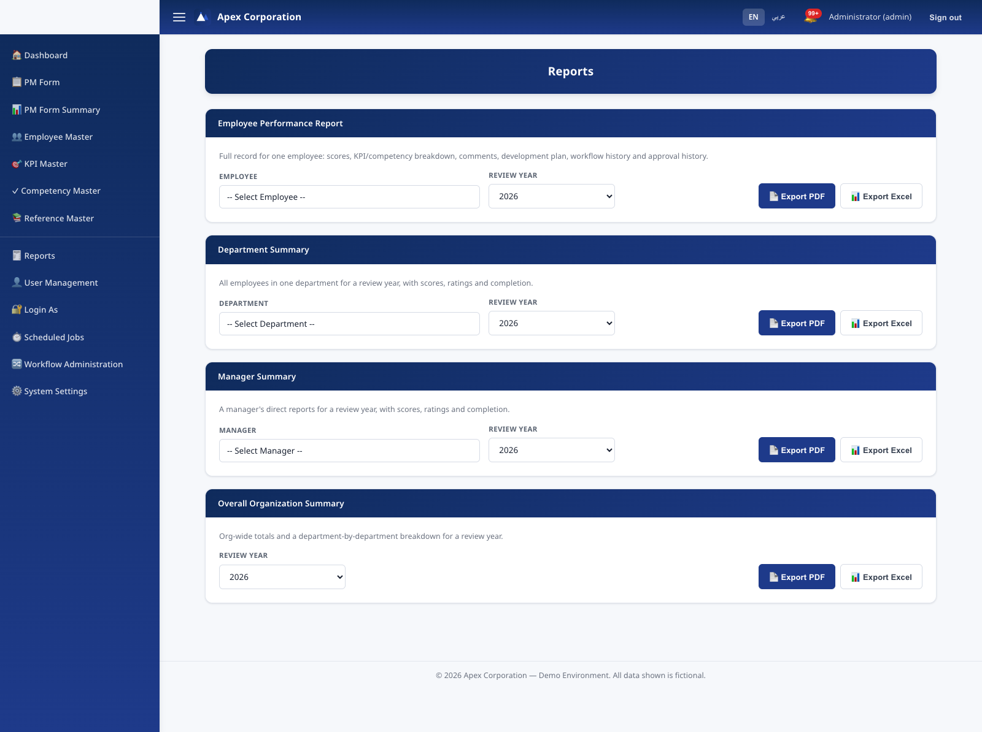
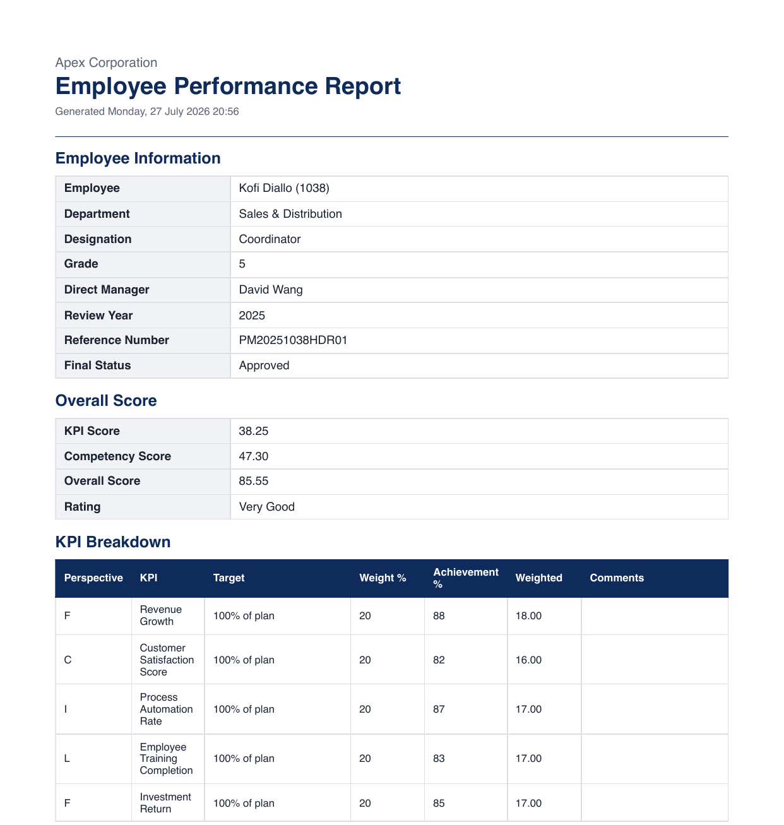
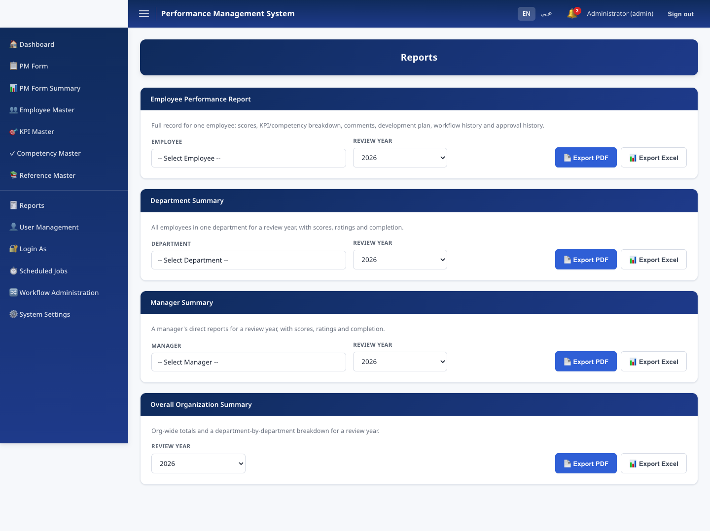
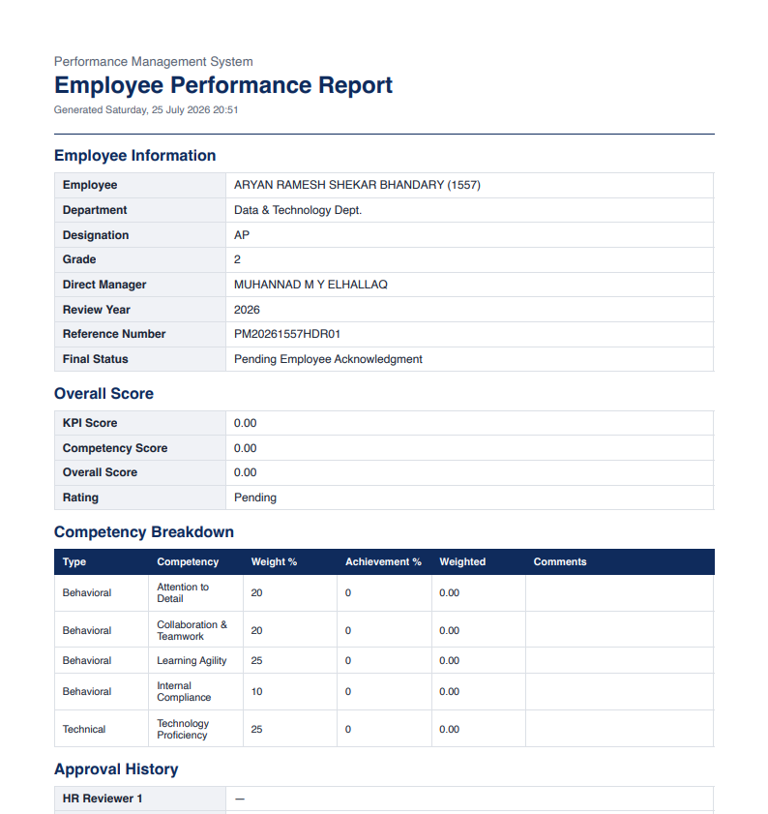
MODULES
Reports — PDF & Excel
Employee, Department, Manager, and Overall Organization summaries — generated fresh from the database on every export, never cached.
Performance Management System · v1.0.0
15

Slide 16
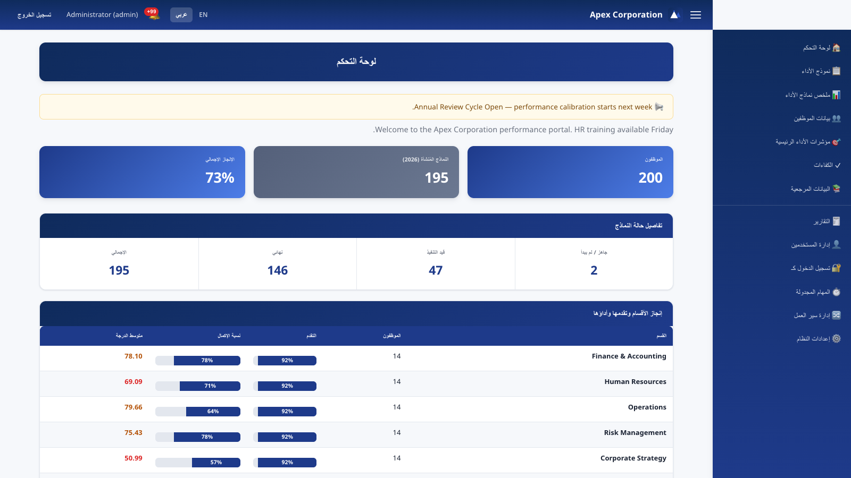
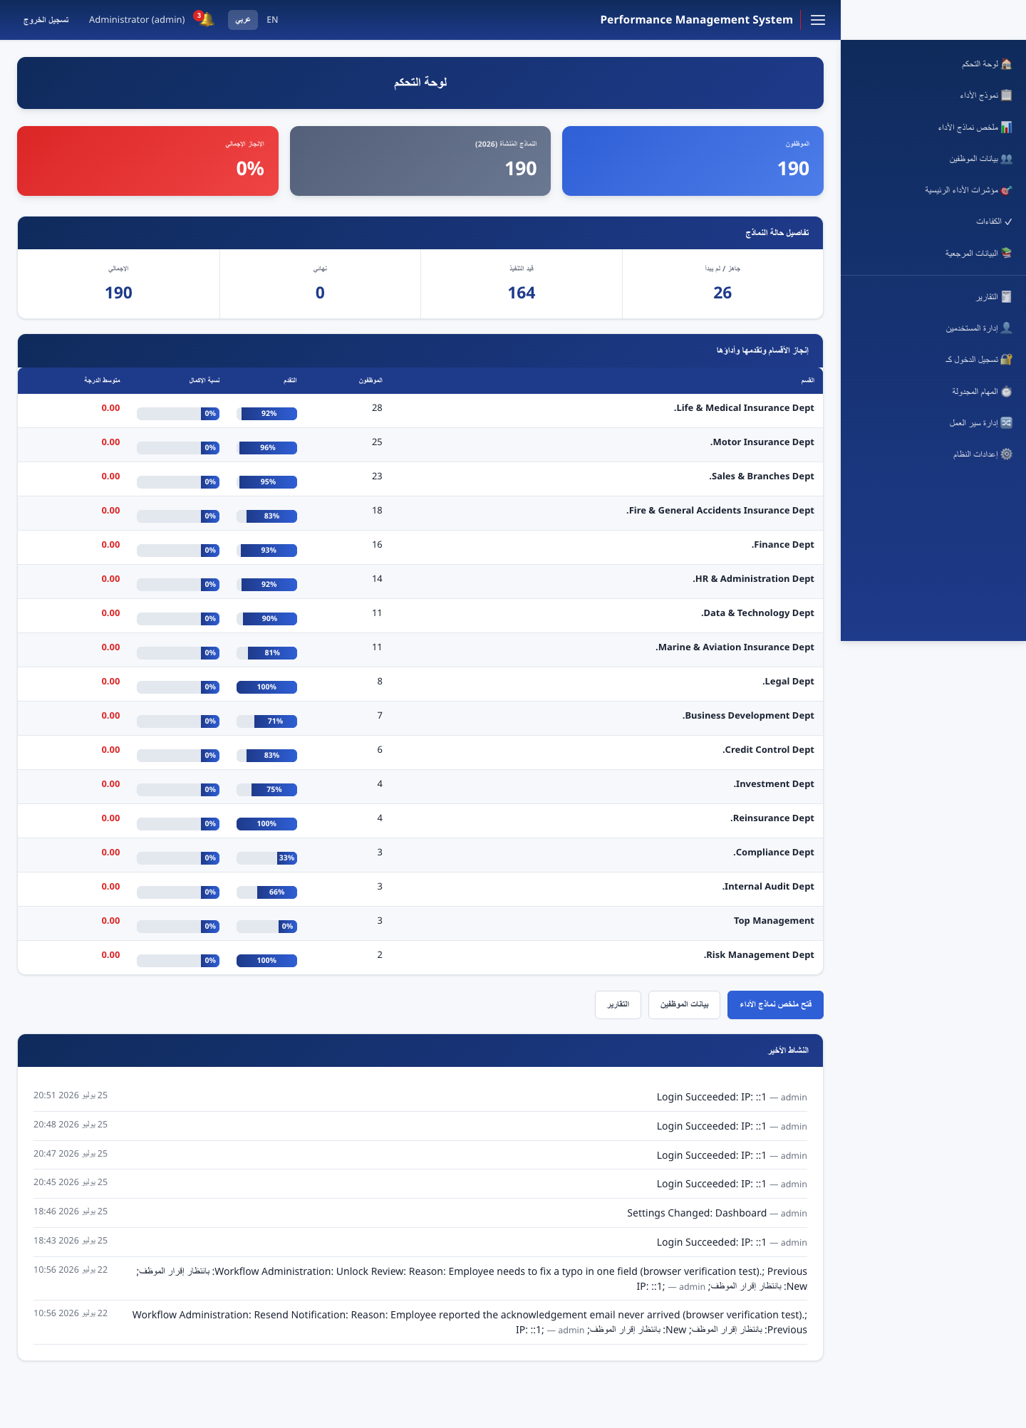
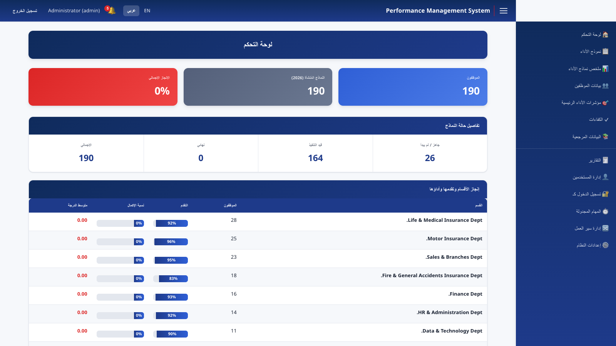
LOCALIZATION
English / Arabic — full RTL mirroring
36 pages, every string translated. RTL is applied at the document level — sidebar, tables, and data all mirror correctly, not just text direction.
Performance Management System · v1.0.0
16

Slide 17
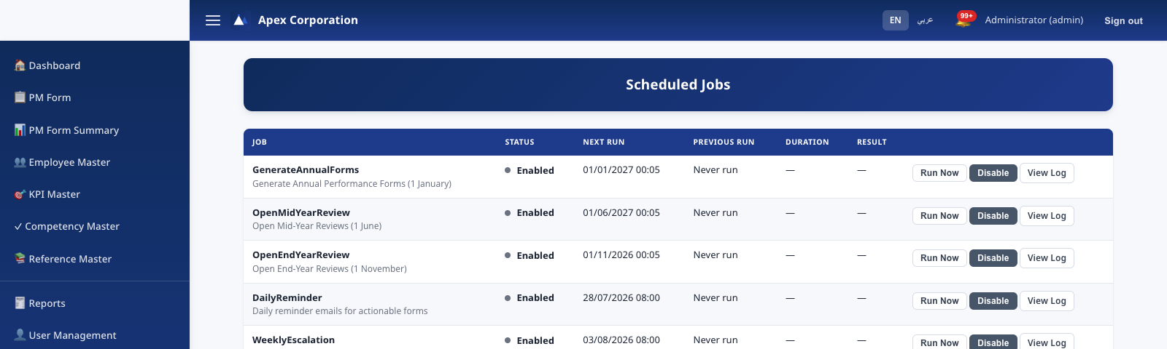
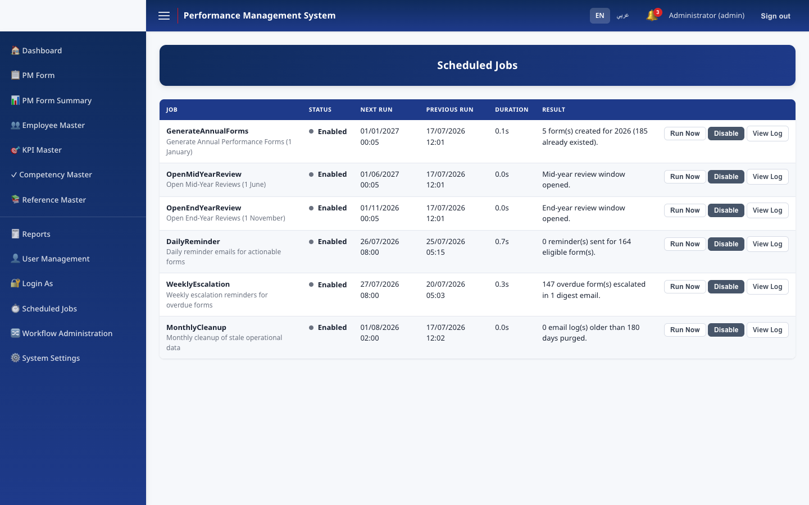
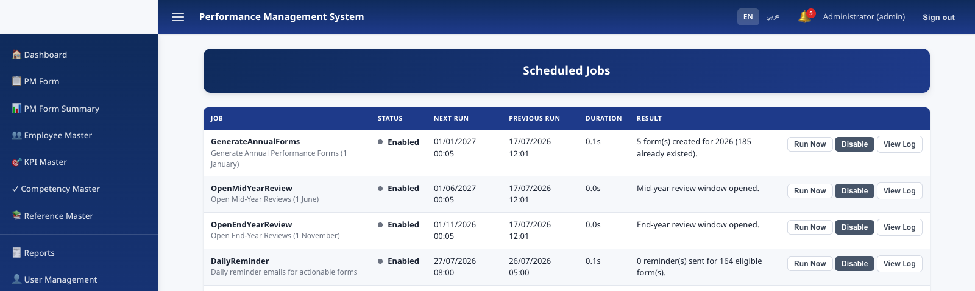
AUTOMATION
Scheduled jobs
Generate Annual Forms
Open Mid-Year Reviews
Open End-Year Reviews
1 January
1 June
1 November
Daily Reminder
Weekly Escalation
Monthly Cleanup
Every day, 08:00
Monday, 08:00
1st of month
Performance Management System · v1.0.0
17

Slide 18
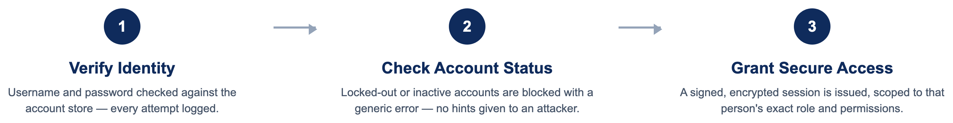
SECURITY
Authentication & authorization flow
Performance Management System · v1.0.0
18
Notes:
Every sign-in goes through the same three checks, no exceptions — including administrator accounts. Failed attempts are logged and rate-limited automatically, and the error message never reveals whether it was the username or the password that was wrong.

Slide 19
SECURITY
Defense in depth
Account lockout applies uniformly — including administrator accounts
SMTP & Login-As passwords encrypted at rest (Data Protection)
Generic error messages prevent username enumeration
Boot guard refuses to start with any unchanged default credential
HTTPS/HSTS + Secure/SameSite cookies in Production
Append-only audit trail — including the audit-toggle event itself
Security response headers (CSP, X-Frame-Options, Referrer-Policy)
Segregated "Login As" impersonation, fully logged, never privilege-escalating
Performance Management System · v1.0.0
19

Slide 20
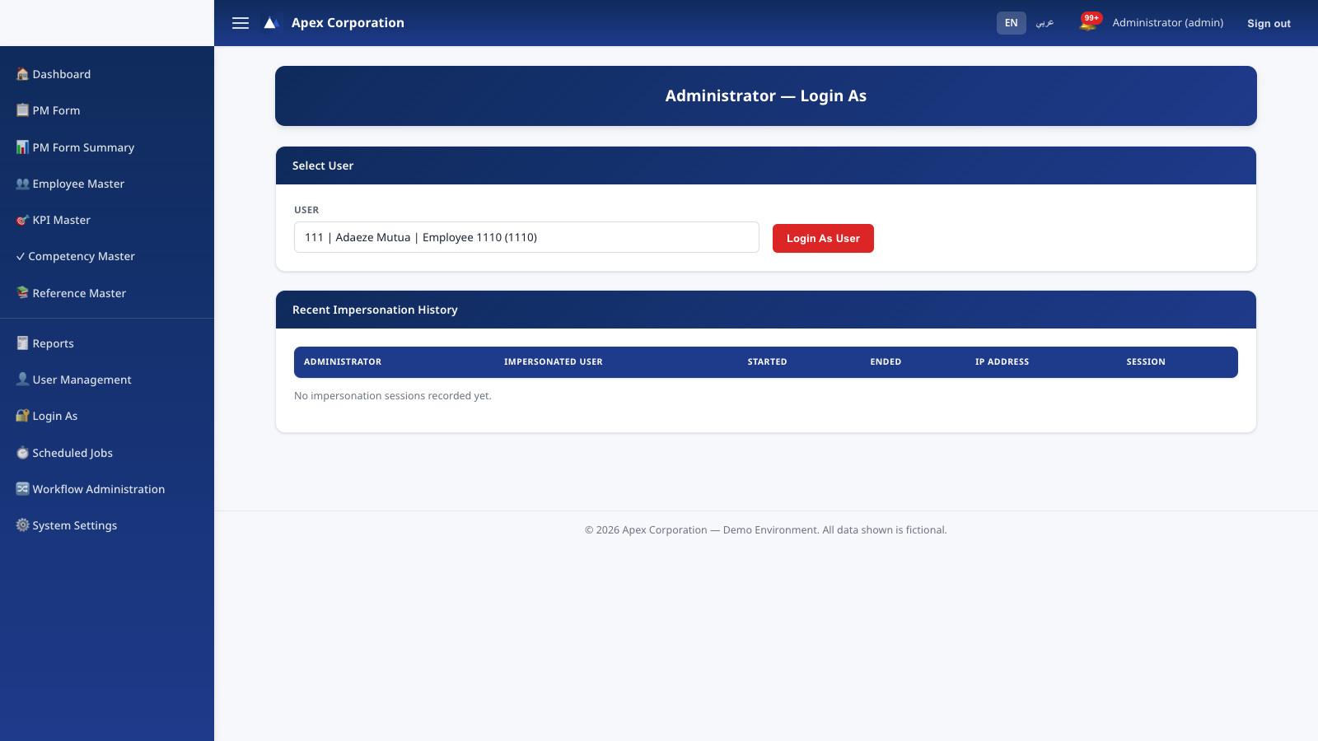
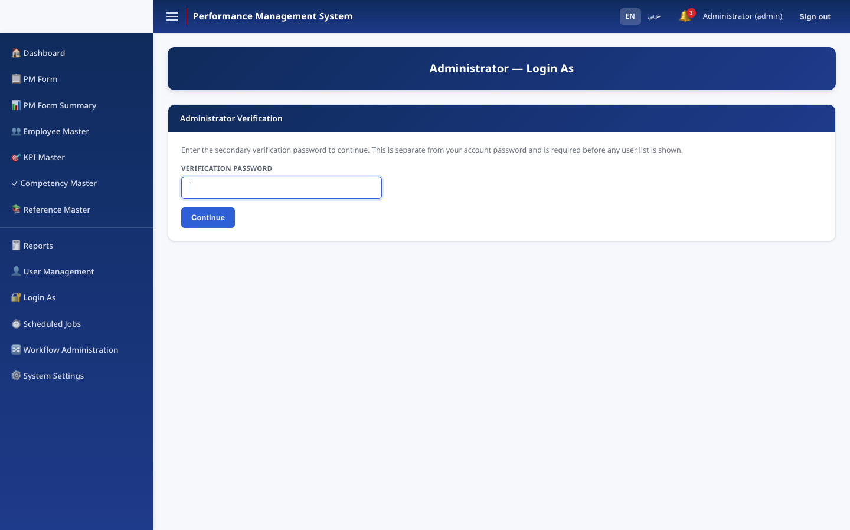
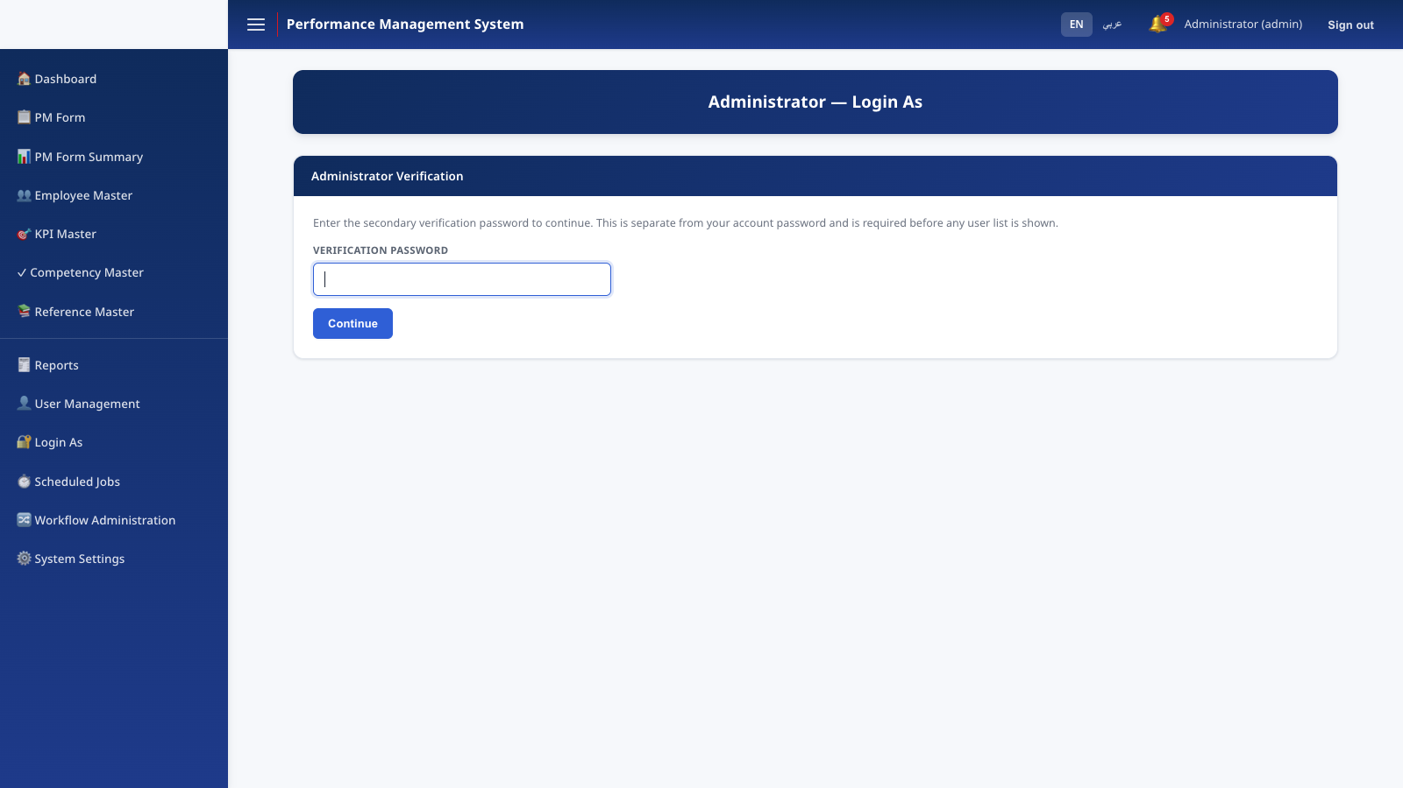
SECURITY
Every action, accounted for
Two independent, append-only records:
Audit Log — login attempts, Workflow Administration overrides, settings changes, user management, department changes.
Impersonation Log — every "Login As" session: who, whom, when, IP — independent of the general audit toggle.
Performance Management System · v1.0.0
20

Slide 21
QUALITY
Testing
An automated test suite exercises every business rule directly, independent of the web application or a live database — so regressions are caught before they ever reach production.
✓
Full workflow state machine — every transition, valid & invalid source states
✓
All six Workflow Administration recovery actions
✓
Permission resolution — self, manager, HR admin, branch viewer, exceptions
✓
Scoring, weighting, and rating-band resolution
✓
Email dispatch — deduplication, redirect, idempotent duplicate prevention
✓
Legacy CSV import reconciliation & idempotency
CI (GitHub Actions) runs build + test on every push and pull request.
Performance Management System · v1.0.0
21

Slide 22
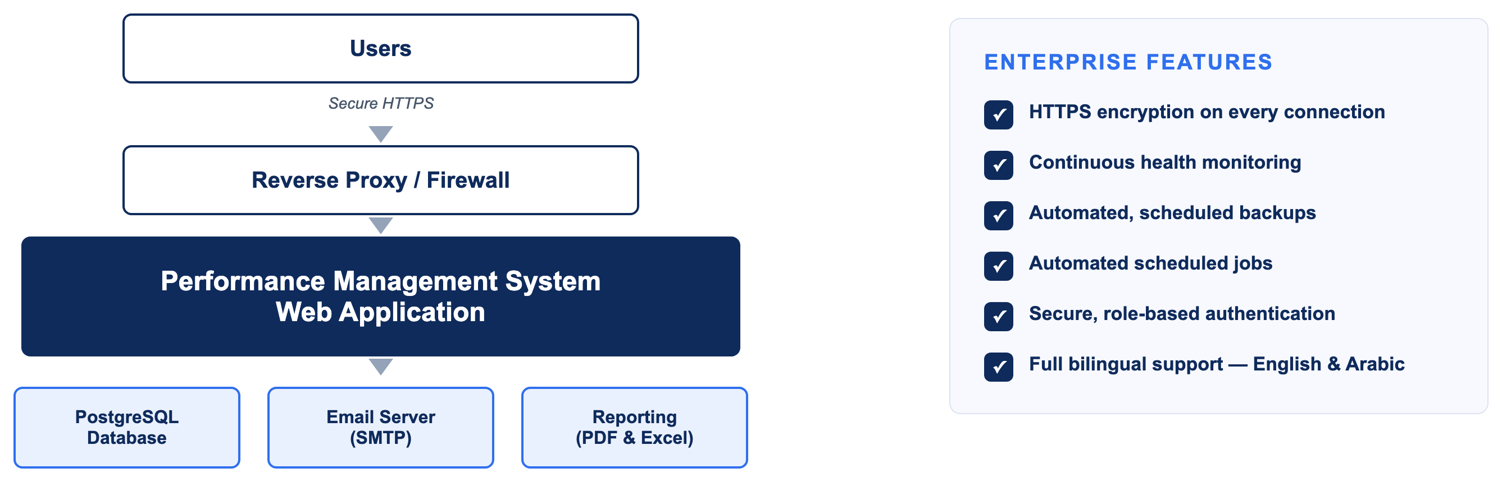
OPERATIONS
Deployment architecture
Performance Management System · v1.0.0
22
Notes:
Every request arrives over encrypted HTTPS and passes through a reverse proxy and firewall before it ever reaches the application. From there, the system talks to its own PostgreSQL database, sends email through your SMTP server, and generates PDF and Excel reports on demand. Health checks, automated backups, and scheduled jobs all run continuously in the background, with no manual intervention required.

Slide 23
V1.0.0
Release readiness
A full production-readiness review across security, authorization, workflow integrity, localization, accessibility, database design, logging, deployment, documentation, and testing.
✓ Security
✓ Authorization
✓ Workflow Integrity
✓ Localization
✓ Accessibility
✓ Database Design
✓ Logging
✓ Deployment
✓ Testing
Every Critical/High-severity finding: fixed and verified — build, automated tests, and live browser verification.
Performance Management System · v1.0.0
23

Slide 24
WHAT'S NEXT
Future roadmap
→
Horizontal scaling — clustered job store, distributed session/cache
→
Nonce-based strict Content-Security-Policy
→
Durable, shared Data Protection key storage for multi-instance deploys
→
Long-term audit-log archival/partitioning strategy
→
Test coverage for Login, Login-As, and PDF/Excel rendering
→
A production-ready Dockerfile for the web application
→
Timezone-aware date gating for review windows
Realistic, not-yet-implemented enhancements — not a description of gaps in the current release.
Performance Management System · v1.0.0
24

Slide 25
Performance Management System
Thank you
Full documentation set — README, User/Administrator/Technical/Database/Workflow/Deployment guides — accompanies this presentation.

